Slide 1
Smart Hospitality management and Engagement Resource Too, with Appointment Booking
Thejas.K.S. (221801056)
Atmakuru Siva Sandeep (221801501)
Giridharan.M (221801504)

Slide 2
Introduction
n today’s fast-paced, globally connected work environment, scheduling meetings efficiently is essential. The process of finding a mutually convenient time can be challenging, especially when dealing with multiple participants, varying time zones, and diverse schedules. This project focuses on developing an innovative 30-minute meeting scheduler that leverages advanced features and AI-driven insights to streamline the scheduling experience, providing a seamless solution to the common pain points in current systems.
This scheduler aims to go beyond the traditional tools by introducing smart availability detection, real-time conflict resolution, and personalized meeting suggestions that cater to user preferences and patterns. By integrating with existing calendar systems, the scheduler will automatically detect available slots, suggest optimal times, and allow users to set preferences such as buffer times, priority hours, and travel times for in-person meetings. Additionally, AI-powered recommendations will facilitate “best fit” time slots and provide dynamic updates if scheduling conflicts arise.
With a user-friendly interface and intuitive features like one-click polling for group scheduling, natural language time selection, and time zone awareness, this project will not only simplify the process of booking 30-minute meetings but also optimize it for efficiency and user satisfaction. This scheduler is designed to serve as a highly adaptable tool for individuals and teams, addressing the complexities of modern scheduling needs and improving productivity across organization

Slide 3
Existing System
Dynamic Slot Suggestions: Offer real-time suggestions that update based on others’ responses or sudden calendar changes.
“Best Fit” Recommendations: Use data to recommend the best slot based on all invitees’ availability, considering commute times, time zone differences, and previous scheduling preferences.
Drag-and-Drop Selection: Allow users to select a 30-minute slot by dragging across the desired time range on a visual calendar.
Color-Coded Availability Blocks: Highlight free, partially free, and busy slots in different colors for quick navigation.

Slide 4
Advantages
Improved Decision-Making
Real-time data: Dashboards provide up-to-date information, helping hospital administrators and clinicians make timely decisions regarding patient care, resource allocation, and emergency response.
Data visualization: Complex data is presented in visual formats like charts, graphs, and tables, making it easier to interpret trends and patterns.
Disadvantages
High Initial Costs
Setup and integration: Implementing a hospital management system with an advanced dashboard can be expensive, involving costs for hardware, software licenses, and technical setup.
Training: Staff will require training to efficiently use the system, which may incur additional costs and time.

Slide 5
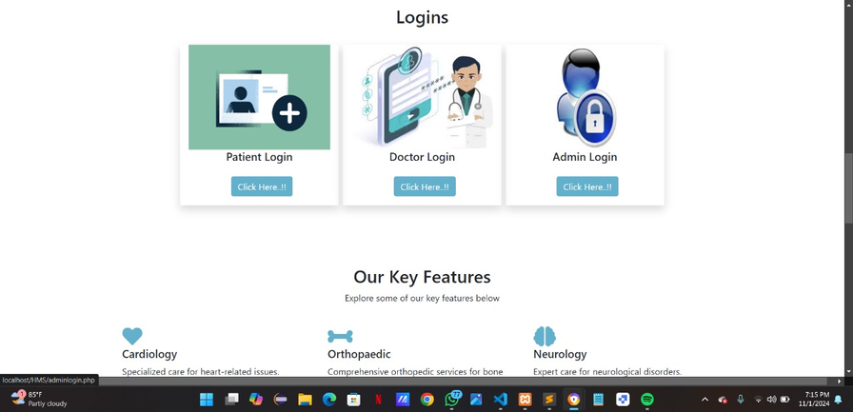
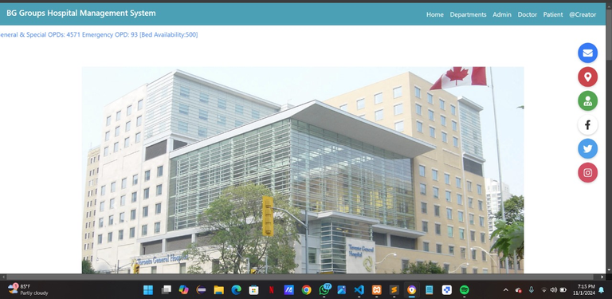
Proposed System
Patient Management
Staff Management
Patient Admissions and Discharges: Track real-time admissions, discharges, and occupancy rates.
Bed Availability: Display current bed status across different wards (ICU, general, maternity, etc.).
Staff Roster and Shift Management: View and manage real-time shifts, schedules, and duty assignments.
Staff Availability: Indicate current availability of doctors, nurses, and other healthcare professionals.

Slide 6
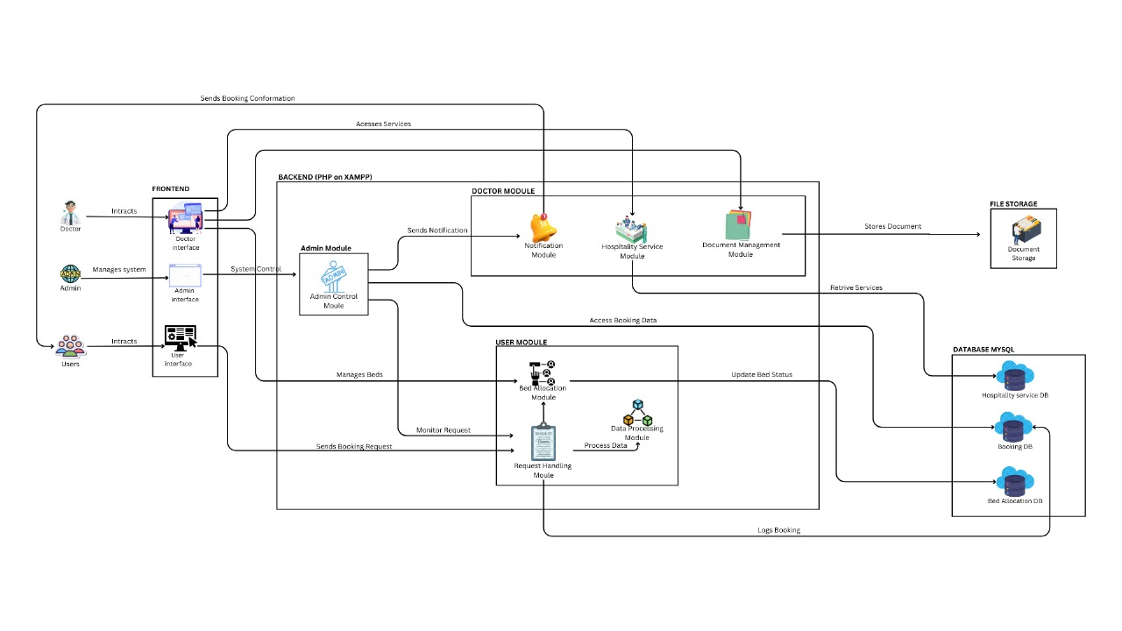

Architecture diagram

Slide 7
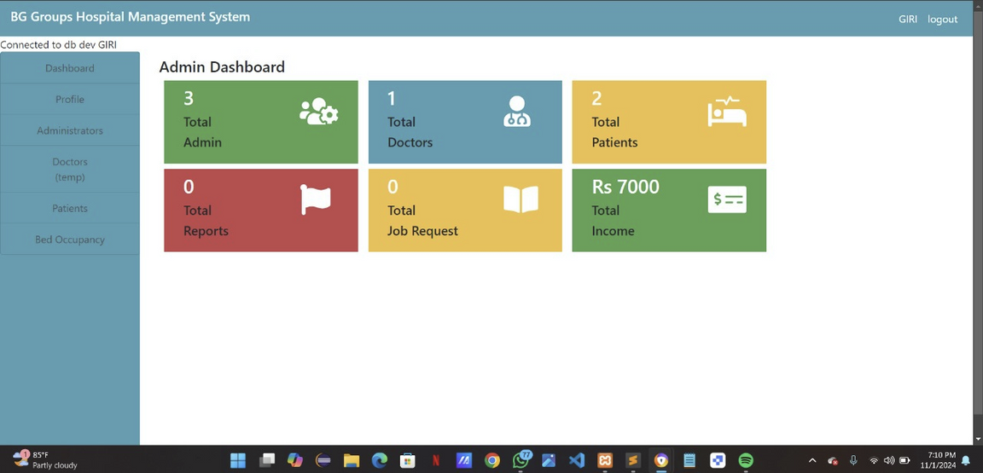
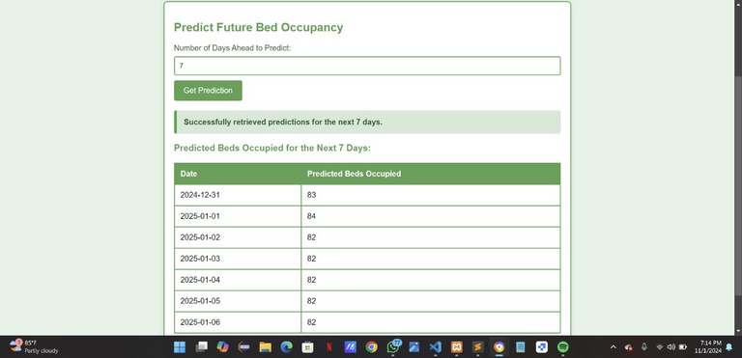
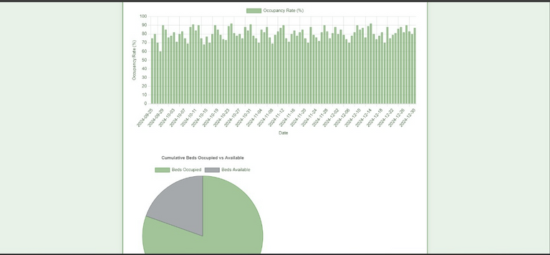
Admin Module
Operational overview
Real-Time Status Updates: Provide live updates on key areas, including patient admissions, discharges, bed occupancy, and staffing levels.
Departmental Performance: Show performance metrics by department (e.g., emergency, ICU, outpatient) to monitor workflow and resource utilization.
1 . Patient waitlist for Bed Assignment
Show a list of patients waiting for bed assignment, categorized by urgency level or priority.
2 . Bed Tunnaround Time
rack how long it takes to prepare a bed for a new patient after a discharge, ensuring efficient use of resources.
Over all Occupancy vs Availability
how a simple division between occupied and available beds, giving a quick snapshot of total capacity.
Color Coding: Use distinct colors (e.g., green for available, red for occupied) for easy interpretation at a glance
Divide the pie chart into sections for each department (e.g., ICU, emergency, general ward) to show occupancy per unit.

Slide 8
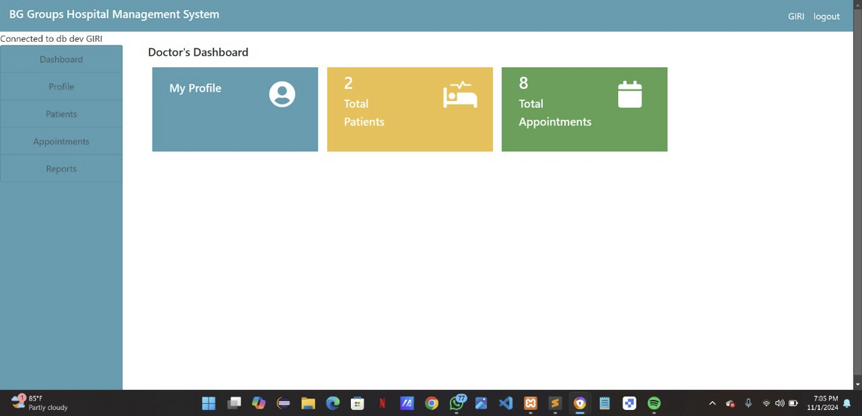
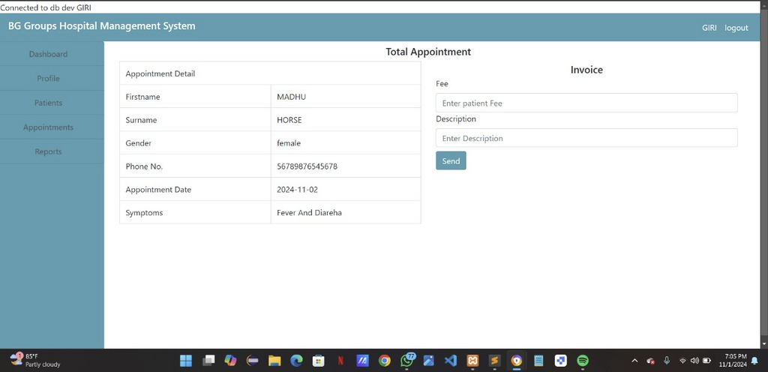
Doctor Module
Patient list and Overview
Daily Schedule: Show the doctor’s schedule, including appointments, rounds, and procedures for the day.
Upcoming Appointments: List appointments for the next few days or week, helping doctors prepare for upcoming consultations.
Appointment Management: Allow the doctor to reschedule, cancel, or modify appointments directly from the dashboard
Appointments and Scheduling
Daily Schedule: Show the doctor’s schedule, including appointments, rounds, and procedures for the day.
Upcoming Appointments: List appointments for the next few days or week, helping doctors prepare for upcoming consultations.
Appointment Management: Allow the doctor to reschedule, cancel, or modify appointments directly from the dashboard

Slide 9
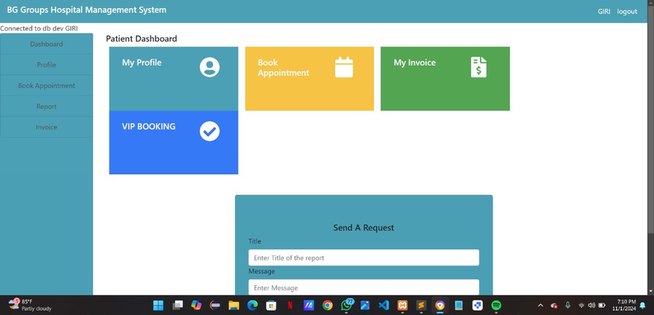
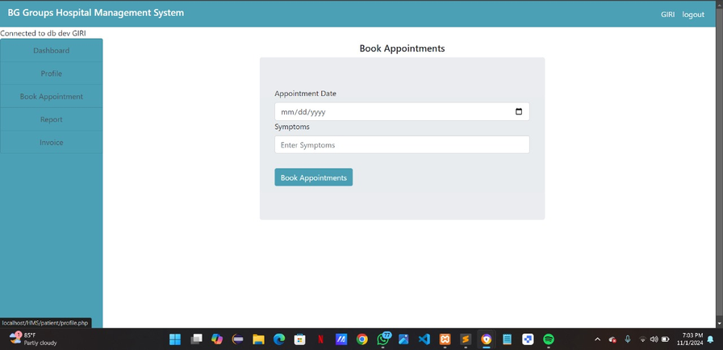
Patients Module
Personal & Medical Information
Patient Profile Summary: Display personal details (name, age, contact info, emergency contact).
Medical History Overview: Provide a quick summary of medical history, including past diagnoses, treatments, allergies, and prescriptions.
Invoices and Billing
nvoice Summary: Display recent and past invoices with details like service breakdown, total cost, and due date.
Billing History: Provide an overview of all invoices, payments, and outstanding balances
Appointments and scheduling
Appointment Calendar: Display upcoming and past appointments, with options to reschedule or cancel as needed.
Telemedicine Access: Provide links to join virtual consultations if applicable.
Symptoms
Related Conditions: Include relevant medical history, such as chronic illnesses, allergies, or recent infections.
Medications and Treatment History: List any current medications, as they may influence or mask symptoms.h text
Describe the nature of the symptom (e.g., pain, fever, dizziness, fatigue).

Slide 10
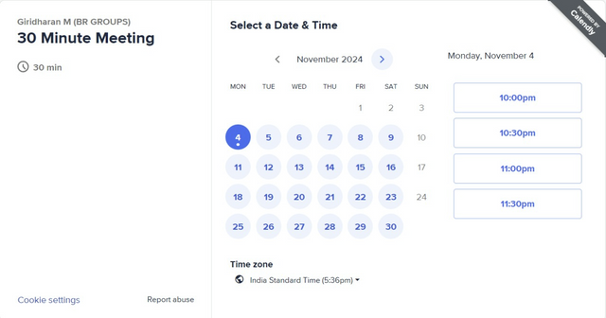
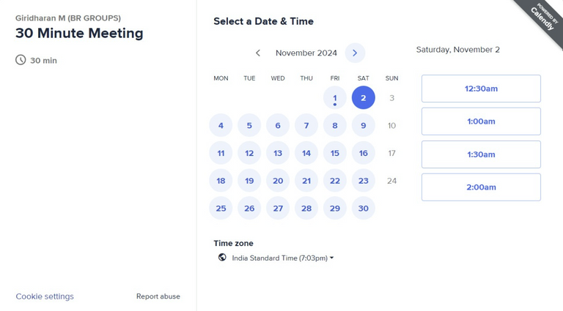
Novile Features
Smart Availability Detection
Calendar Integration: Sync with users' personal or work calendars to automatically detect available 30-minute slots.
Suggested Times Based on Preferences: Use AI to suggest optimal times based on past meeting patterns, preferred working hours, or mutual availability of all participants.
Interactive Time Picker
Drag-and-Drop Selection: Allow users to select a 30-minute slot by dragging across the desired time range on a visual calendar.
Color-Coded Availability Blocks: Highlight free, partially free, and busy slots in different colors for quick navigation.

Slide 11
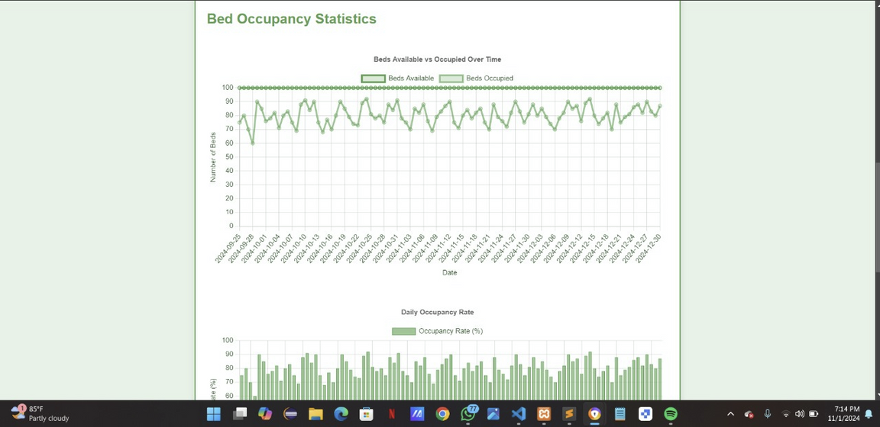
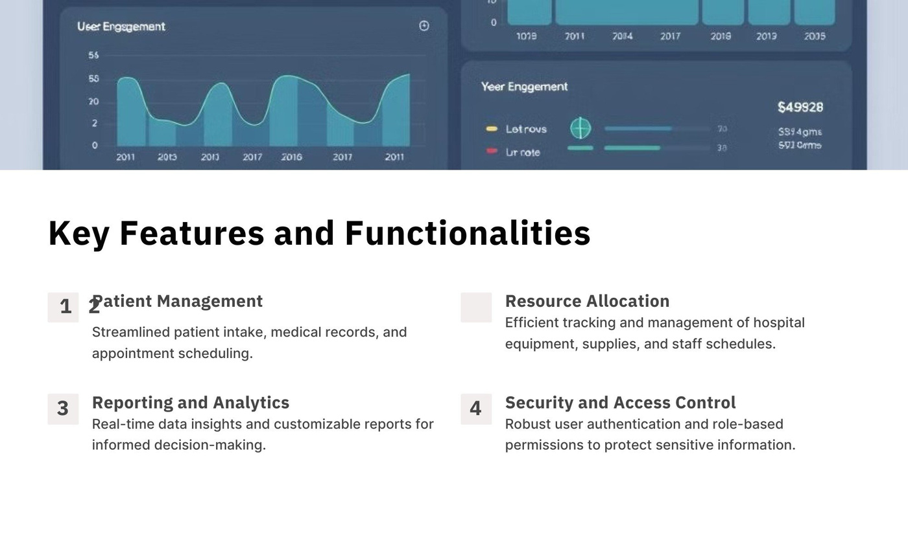
Patient
2

Slide 12
Testing
1.Functional Testing
2.Performance testing{first bit}
3.API testing{postman}

Slide 13
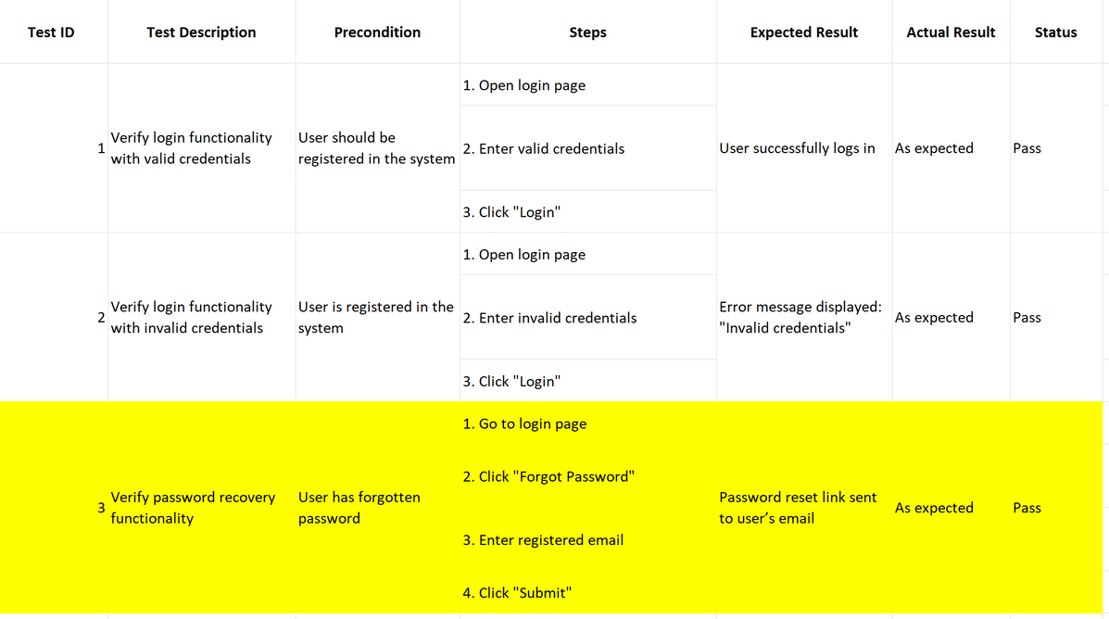
1.Funtional Testing

Slide 14
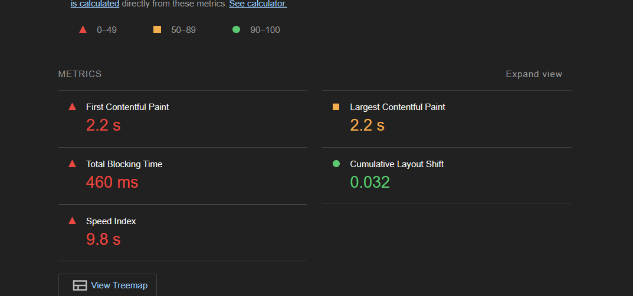
Performance testing

Slide 15
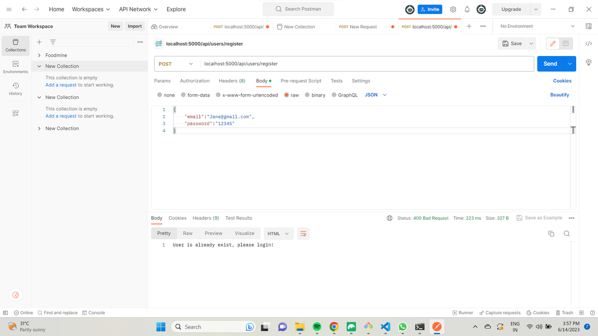
API Testing

Slide 16
Output-Admin

Slide 17
Output - Doctor

Slide 18
Output - Patient

Slide 19
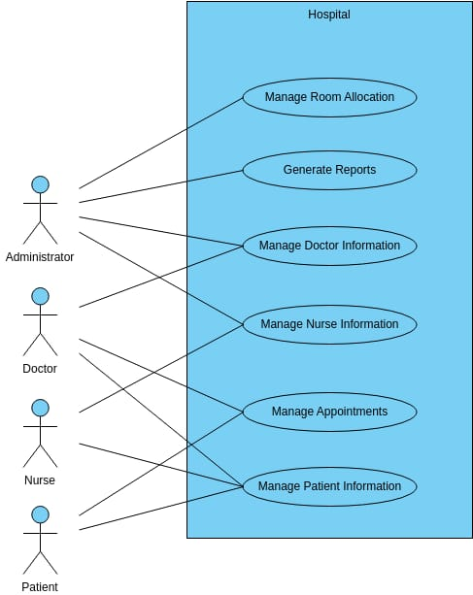
Data Flow Diagram

Slide 20
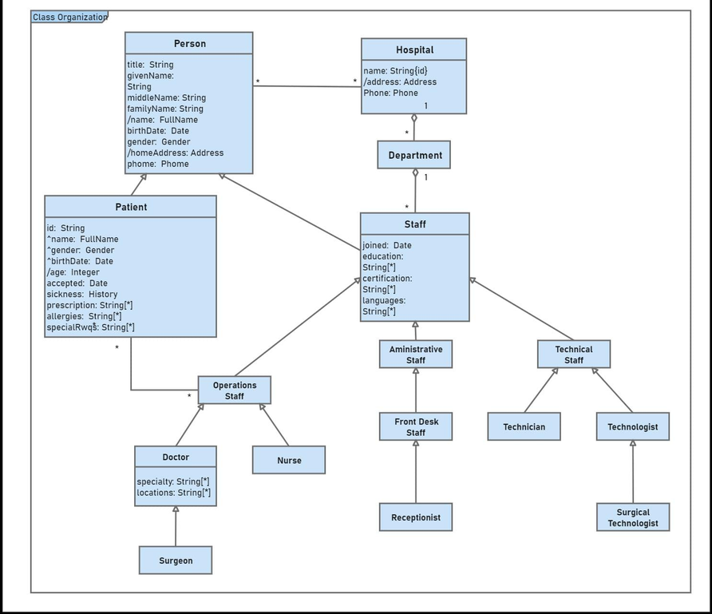
UML Diagram

Slide 21
Conclusion and future enhancement:
In conclusion, the hospitality management system developed for this project successfully fulfills its primary objectives by providing a streamlined, user-friendly platform for booking management, bed allocation, and service organization. Built on a PHP backend with a MySQL database managed through phpMyAdmin, the system allows both users and administrators to navigate booking processes seamlessly. Users are able to view, create, and manage reservations, while administrators have comprehensive control over bookings, bed allocation, and service updates. The intuitive interface and clear organization of services not only make it easy for users to access information but also support administrators in efficiently overseeing and updating resources. This creates a cohesive experience that improves the quality of hospitality services offered, ensuring that guests feel valued and administrators remain well-equipped to manage all aspects of booking and accommodation.
Third-Party API & Payment Gateway Integration: Enhance the platform by connecting with booking sites and payment gateways. This offers users more options and allows seamless, cashless transactions, improving convenience and accessibility.
Real-Time Analytics Dashboard: Implement a real-time dashboard with visual insights on occupancy, bookings, and service usage. This feature would assist administrators in making informed decisions to boost efficiency.

Slide 22
Reference
[1]R. Batra and A. S. Pall, “Barriers to adoption
of hospital management systems: A study of
Punjab healthcare industry,” Prabandhan:
Indian Journal of Management, vol. 9, no.
11, 2016, doi:
10.17010/pijom/2016/v9i11/105320.
[2] R. G. Misal, “Advanced Hospital
Management System,” Int J Res Appl Sci
Eng Technol, vol. 10, no. 6, 2022, doi:
10.22214/ijraset.2022.43686.
[3] P. K. Yadav and R. Kumar, “Online
Hospital Management System,” SSRN
Electronic Journal, 2022, doi:
10.2139/ssrn.4104606

